Slide 1
Developer Documentation
Project Overview
Authors: Adrián Dominik Tüske, Erik Molnár, Zalán Zima

Slide 2
Task Overview
Provides a solution to a real-world problem
Implements data storage and management
Client-side and server-side components using RESTful architecture
Responsive design for desktop and mobile

Slide 3
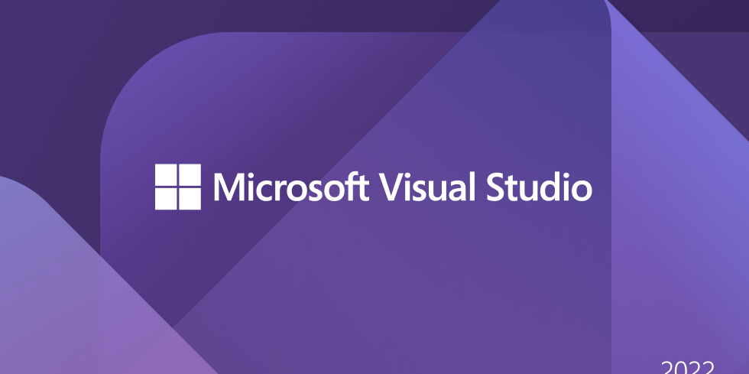
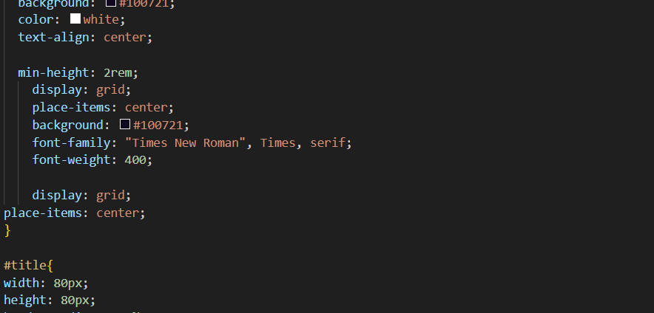
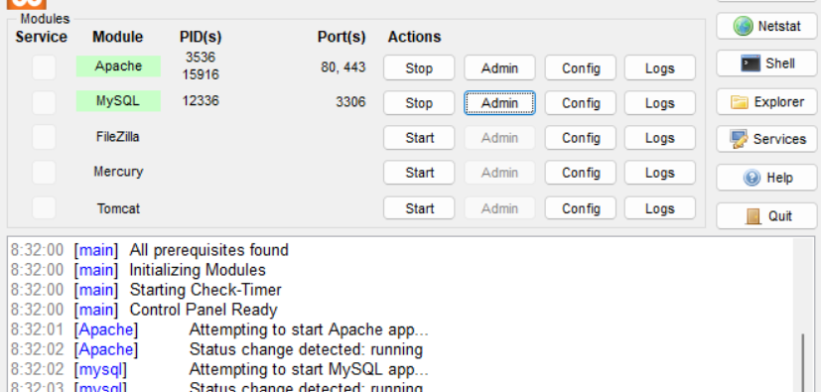
Development Environment
HTML, CSS, JavaScript, React, C#
Visual Studio, Visual Studio Code
XAMPP for
FrontEnd / BackEnd development
Languages used
Local server

Slide 4
Project Structure
HTML
CSS
JavaScript
Defines structure
Styles and layout
Interactivity
React
Backend
Web and native user interfaces
XAMPP, phpMyAdmin

Slide 5
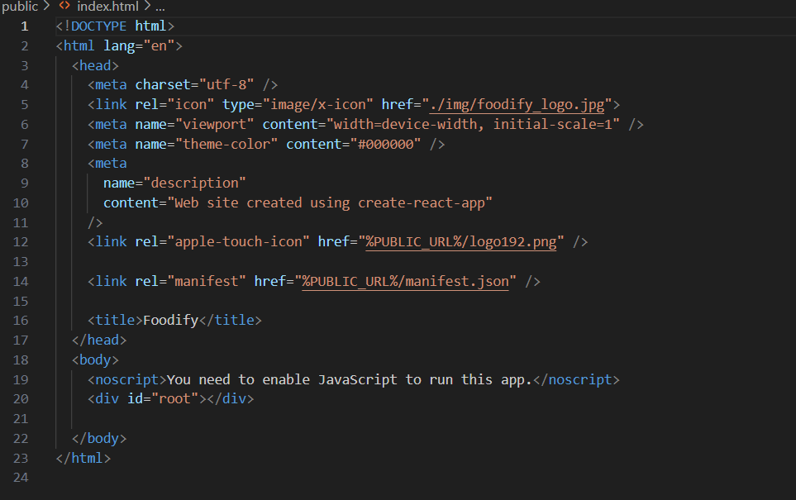
HTML Code
Used for structuring web content
Implements sections like navigation, categories, and forms

Slide 6
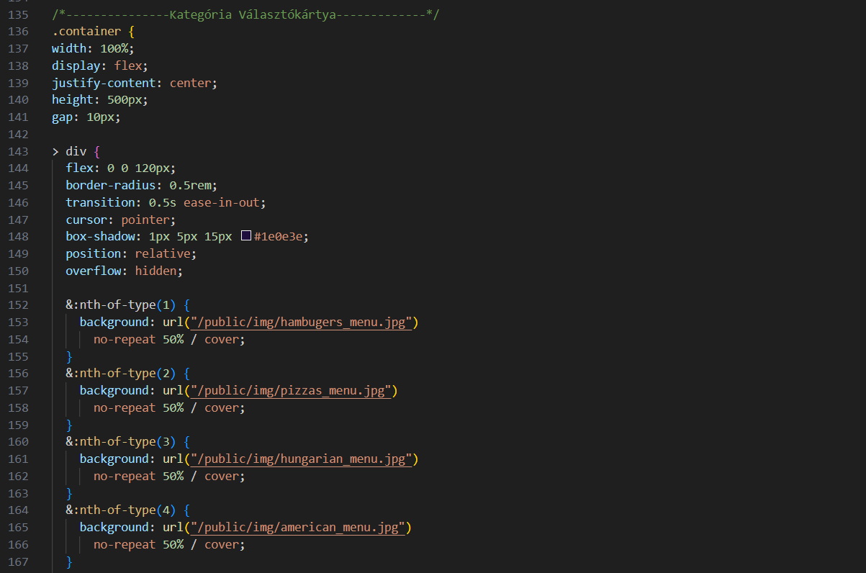
CSS Styling
Defines layout, colors, and animations
Implements hover effects and responsive design

Slide 7
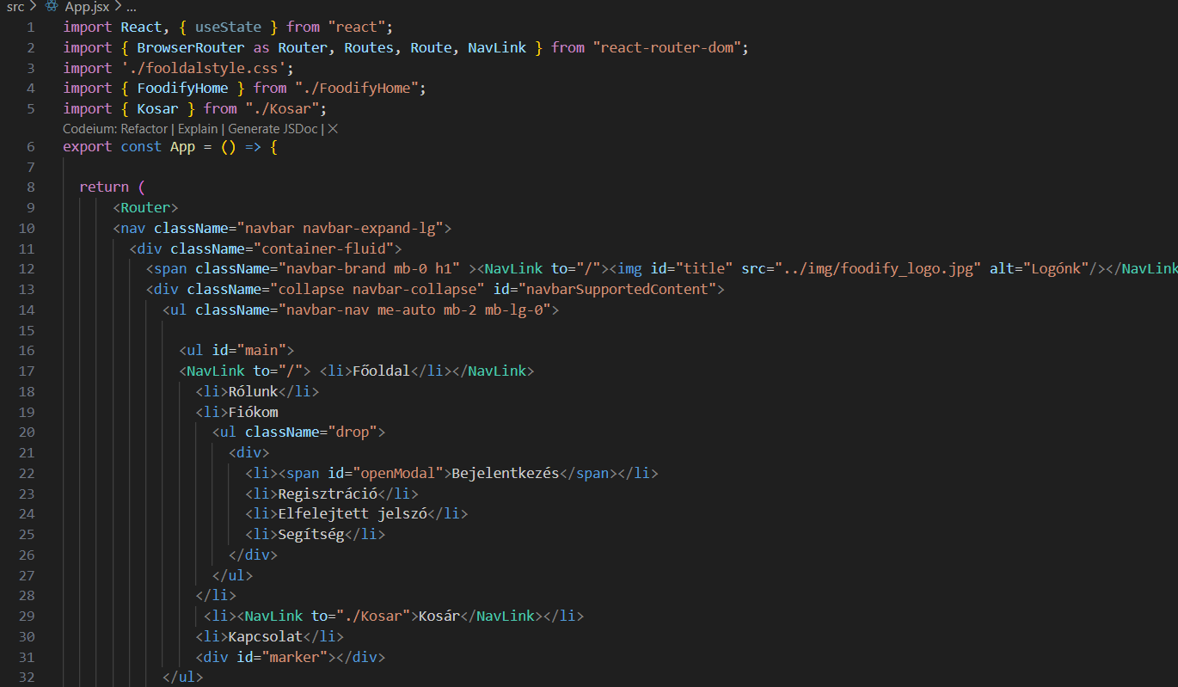
React Functionalities
Create user interfaces from components
Write components with code and markup

Slide 8
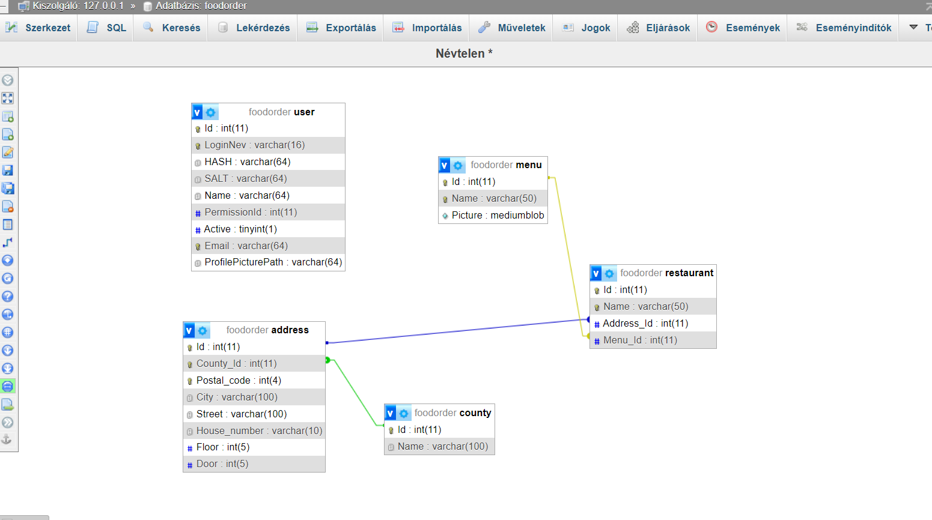
Database and Backend
Uses XAMPP (Apache, MariaDB, PHP, Perl)
phpMyAdmin for database management
Handles user authentication and data storage

Slide 9
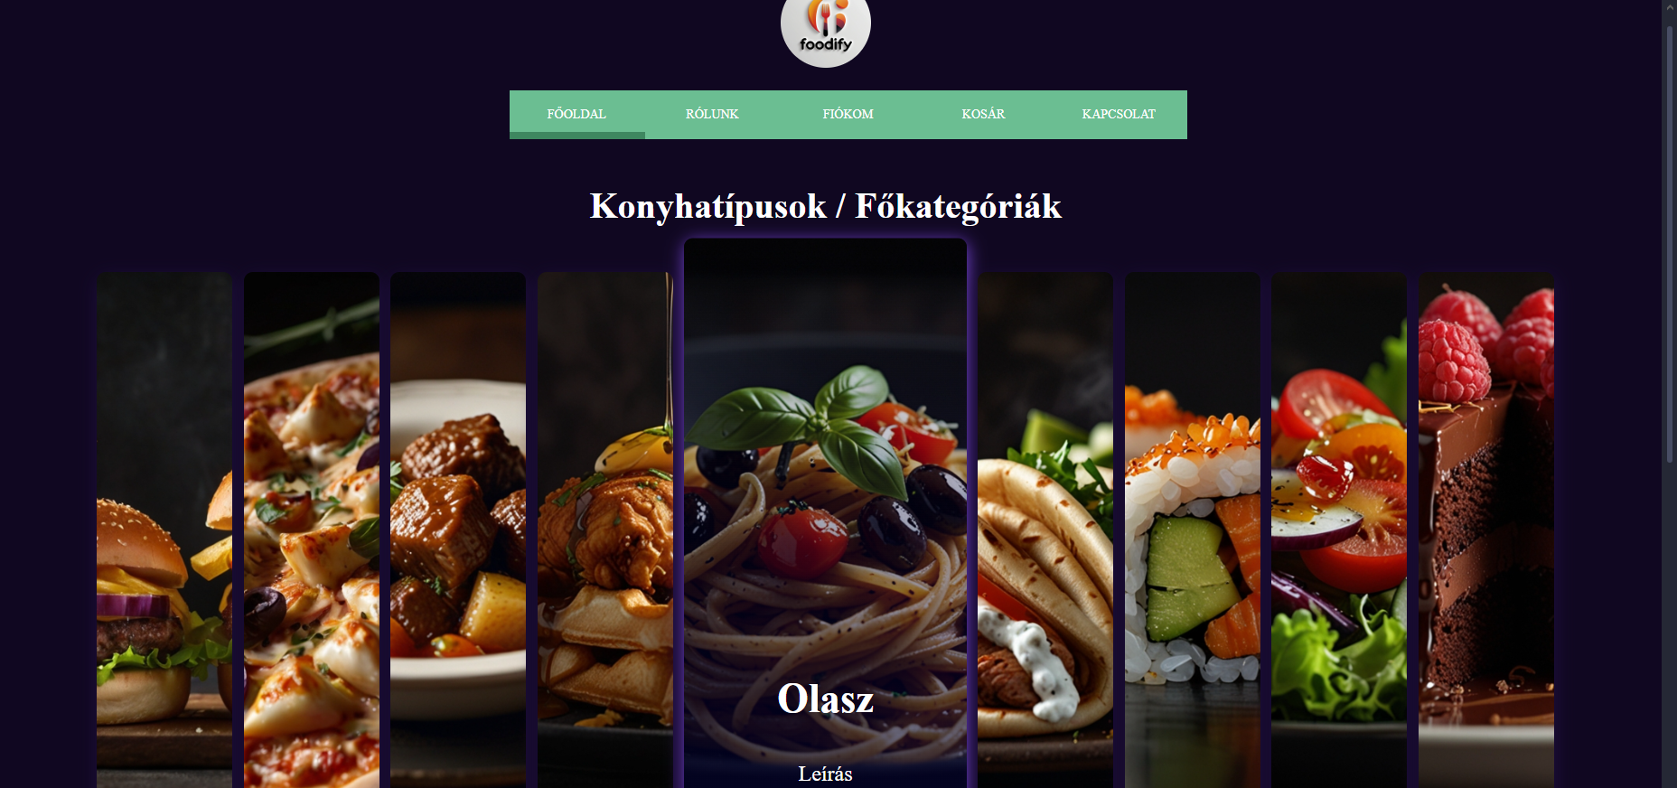
Website Features
Foodify: A food-themed website
Category selection: American, Italian, Chinese, Dessert, etc.

Slide 10
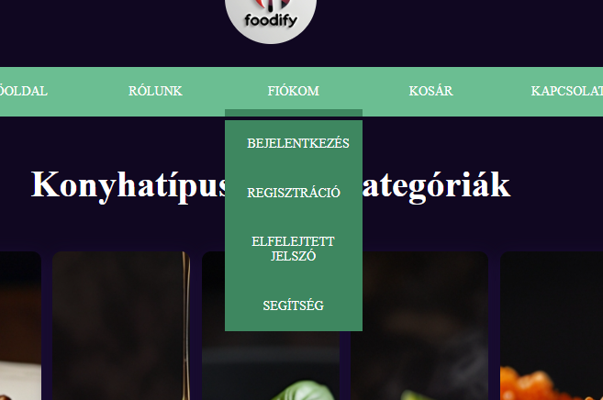
Interactive Elements
Category selection menu with animation
Hover effects enlarge selected category
Sidebar expands/collapses

Slide 11
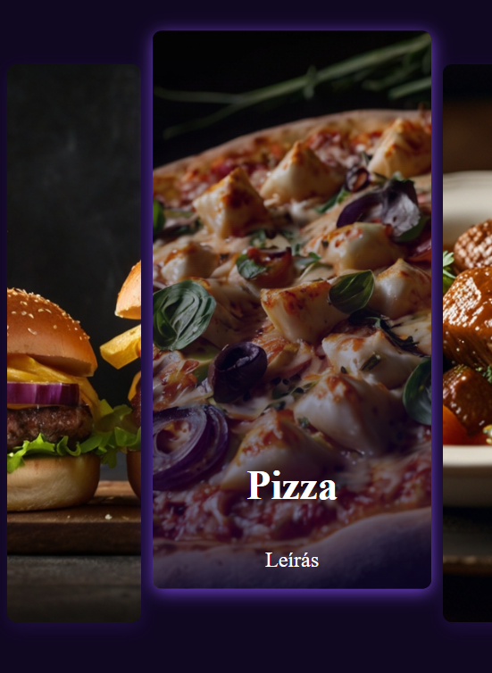
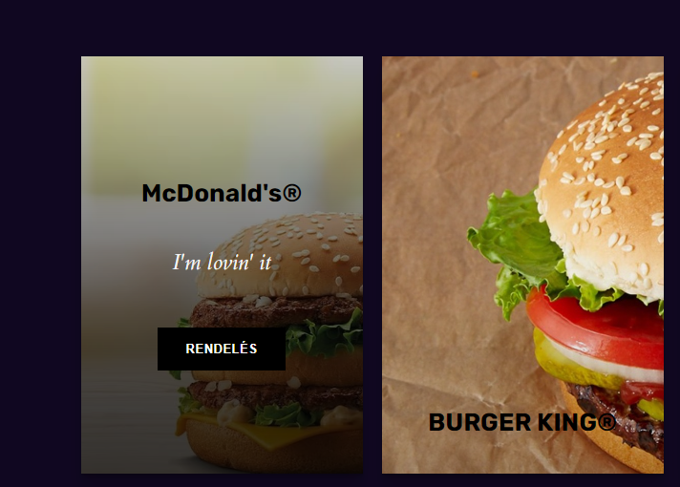
CSS Animations and Effects
Uses flexbox for alignment
Buttons with hover effects
Smooth transitions for better UX

Slide 12
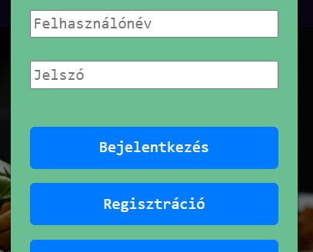
Future Improvements
Backend integration for user accounts & orders
Search & filter functions
Mobile-friendly enhancements

